Slide 1

CSE 350 Digital Electronics and Pulse Techniques
DTL - NAND Gate
Course Instructor: Shomen Kundu (SDU)
Mail: shomen.kundu@bracu.ac.bd
Desk: 4N166

Slide 2
DTL
DTL : Diode Transistor Logic
Bipolar :
Saturated ( Switching transistor will be operating in cutoff or saturation mode)
Input terminals connect through a diode to a transistor’s base terminal.

Slide 3
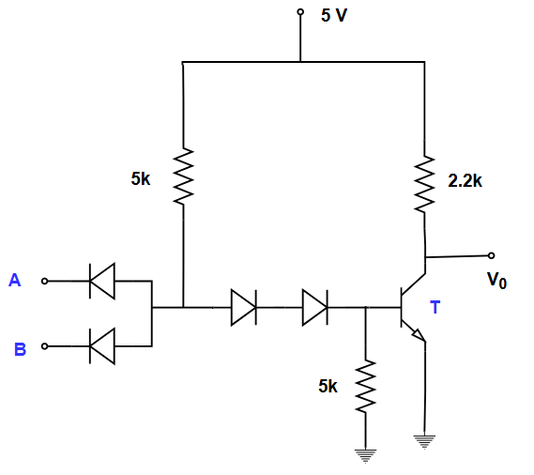
DTL NAND Gate
Basic Operation:
DTL NAND Gate
2 input AND gate + Inverter

Slide 4
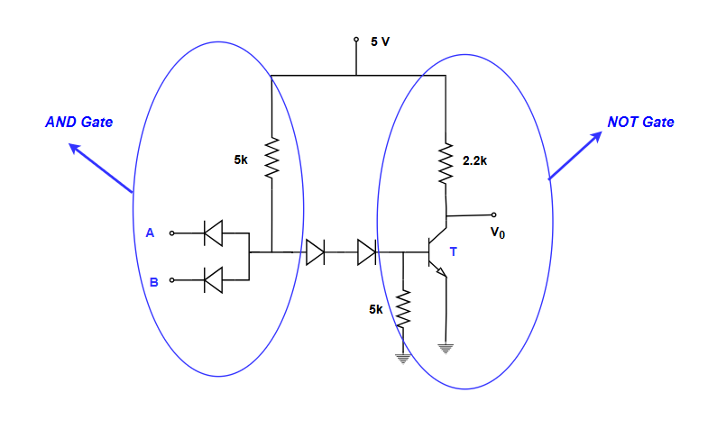
DTL NAND Gate
Basic Operation:
DTL NAND Gate
2 input AND gate + Inverter

Slide 5
DTL NAND Gate
Example: Calculate the currents and node voltages for the following DTL gate. Verify it is a NAND gate. Input of the DTL NAND gate might be connected to the output of other DTL NAND gate.

Slide 6
DTL NAND Gate
V_{A} | V_{B} | V_{o}
0.2 | 0.2
0.2 | 5
5 | 0.2
5 | 5

Slide 7
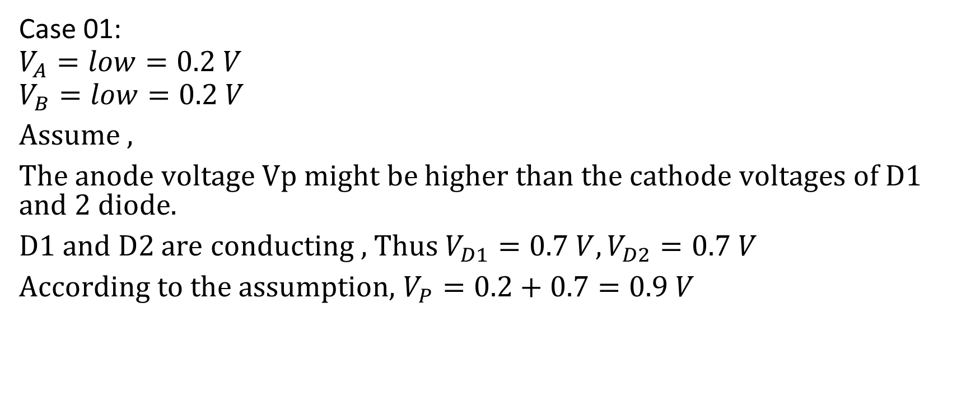
DTL NAND Gate

Slide 8
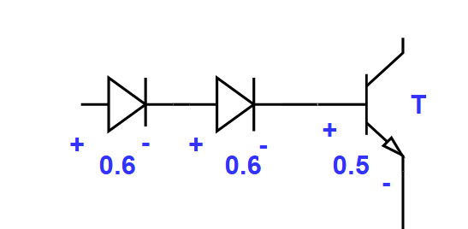
DTL NAND Gate
# In order for T transistor to turn on we need to have V_{BE} = 0.5 ( cut in voltage of transistors ) , we also need to have VD3 = VD4 = 0.6 V ( Cut in voltage for diode )
As a total we require,
VD3 + VD4 + V_{BE} = 0.6 + 0.6 + 0.5 = 1.7 V at p node to turn on the right side of the circuits.
Necessary condition to turn the transistor T.
If V_{P} = 0.9 V, then T can not turn on. This justifies our assumption.

Slide 9
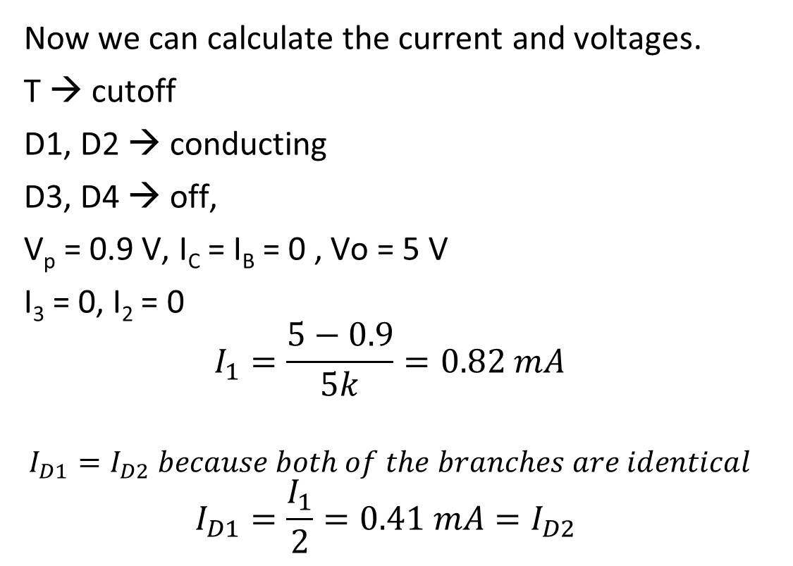
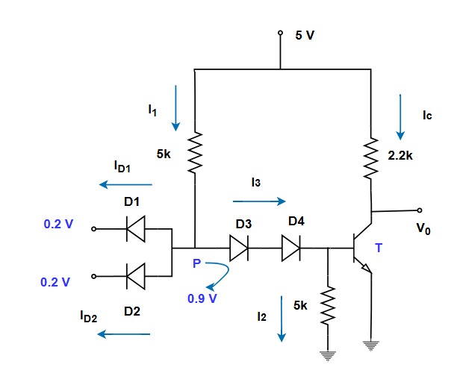
DTL NAND Gate

Slide 10
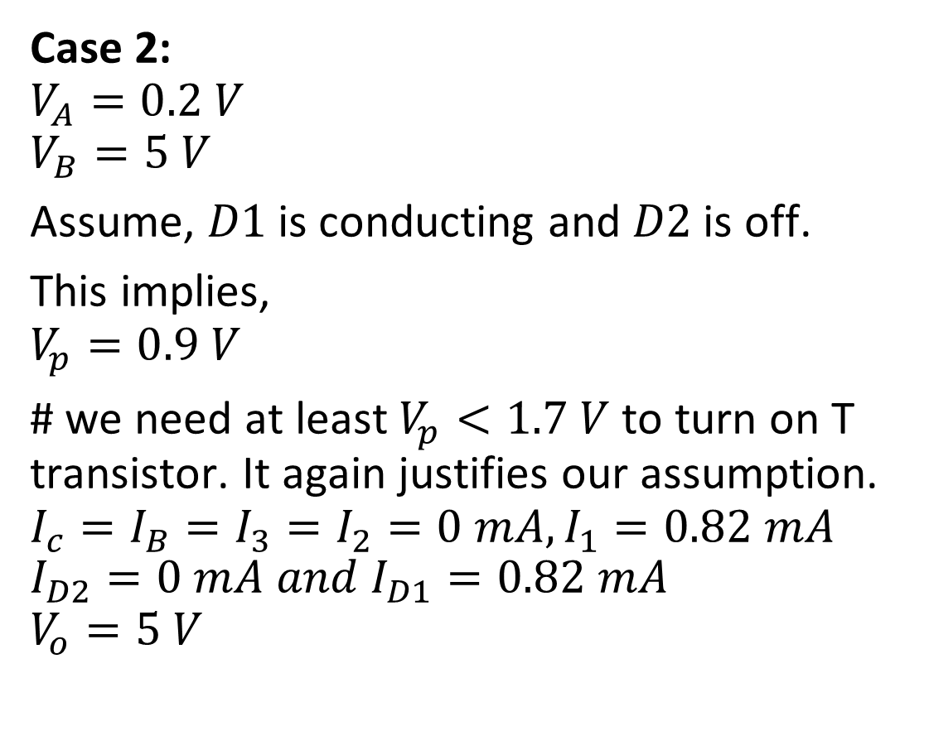
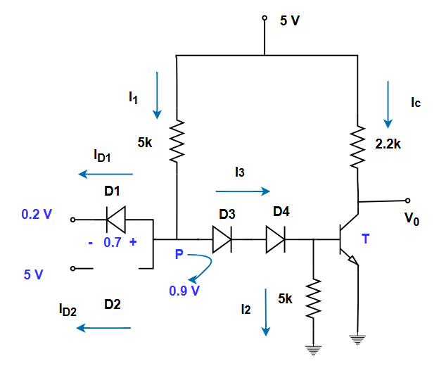
DTL NAND Gate

Slide 11
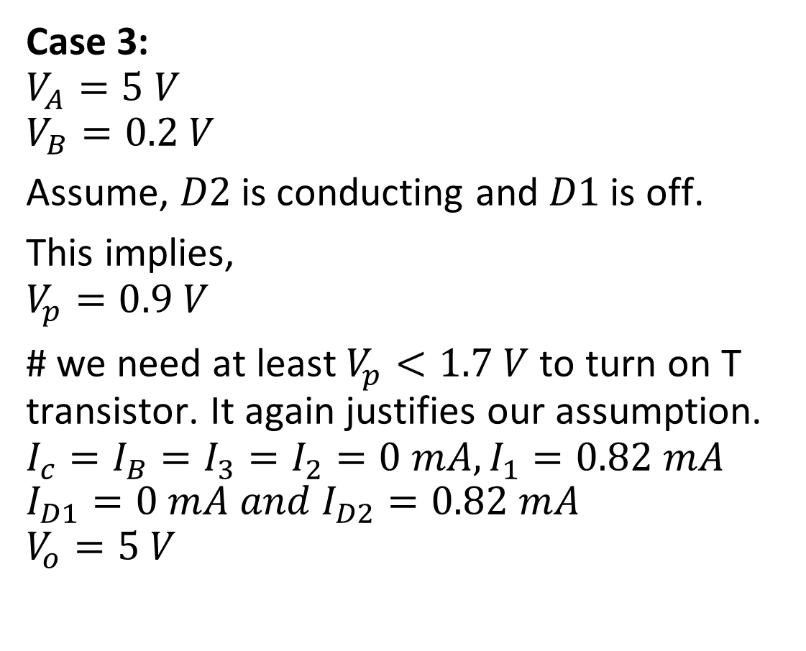
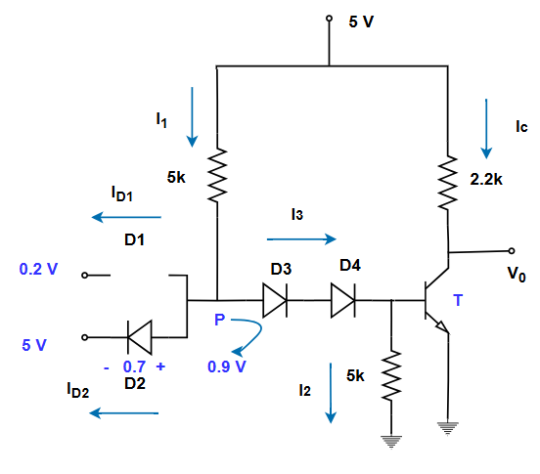
DTL NAND Gate

Slide 12
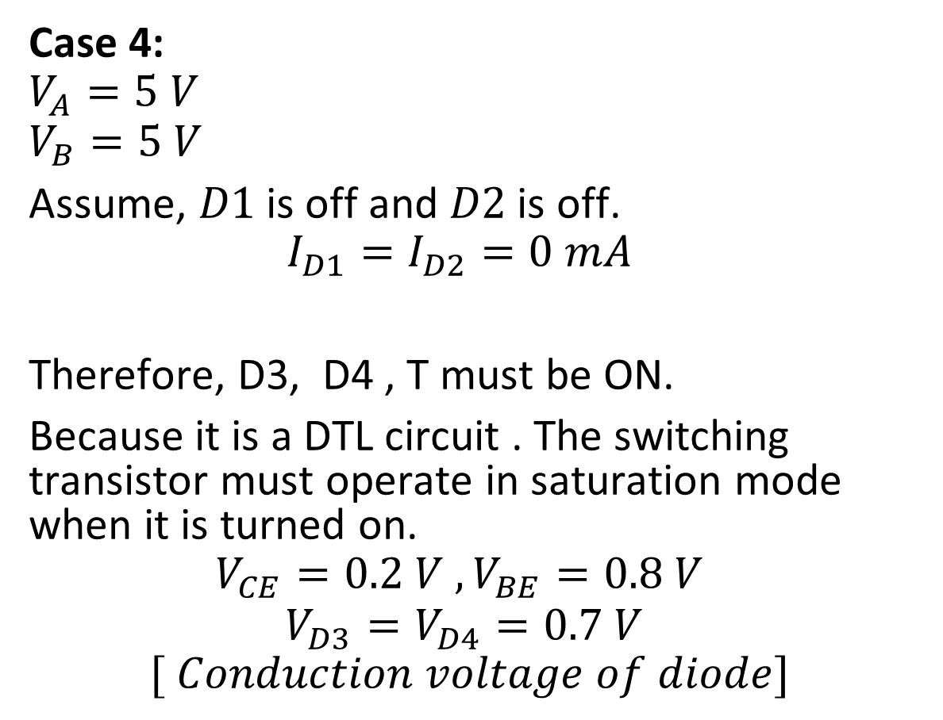
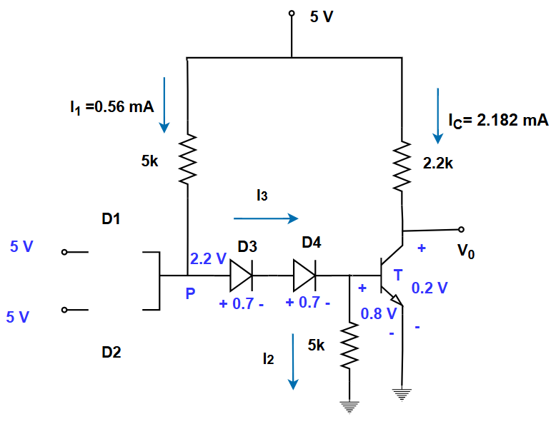
DTL NAND Gate

Slide 13
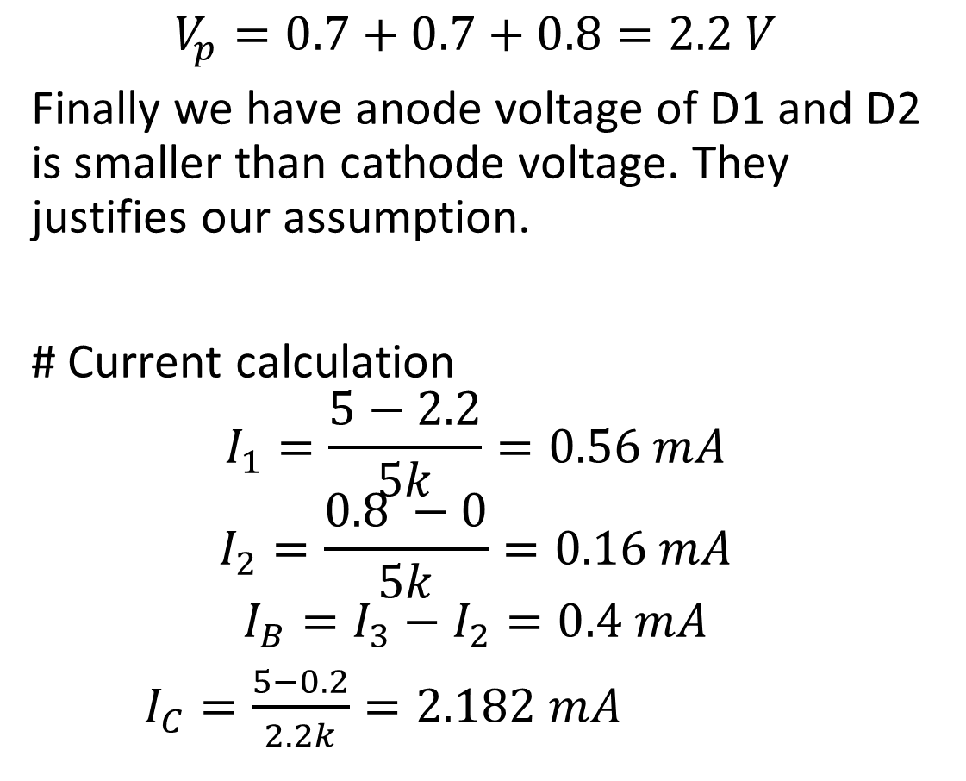
DTL NAND

Slide 14
DTL NAND
From the analysis we can get, the input output relationship. This indicates a NAND gate.
VA | VB | Vo
0.2 | 0.2 | 5
0.2 | 5 | 5
5 | 0.2 | 5
5 | 5 | 0.2

